Slide 1
ADVENTURE WORKS
PROJECT
Sales Dashboard Project
Using SQL • Excel • Power BI • Tableau
Group 6
Sunita | Manoj Gowda | Sreeram | Yashwanth
Rashmi Sama | Vidya Hanchinal | Ayush
MySQL
Excel
Power BI
Tableau

Slide 2
PROJECT OVERVIEW
🎯 Objective
🛠️ Tools Used
📊 Outcome
Analyze AdventureWorks sales data end-to-end
Build dashboards using 4 industry tools
Identify key business insights from data
Present findings clearly to stakeholders
MySQL – Data querying & backend analysis
Excel – Pivot tables, charts & basic BI
Power BI – Interactive KPI dashboards
Tableau – Visual storytelling & insights
Fully functional multi-tool dashboards
Actionable KPIs for business decisions
Sales trends & top product insights
Comprehensive group project report

Slide 3
DATASET OVERVIEW – AdventureWorks
The AdventureWorks database simulates a bicycle manufacturing company's sales operations. It contains multiple relational tables used for end-to-end analysis.
📋
Orders
👥
Customers
OrderID
CustomerID
ProductID
OrderDate
Quantity
TotalAmount
CustomerID
FirstName
LastName
City
Country
Segment
📦
Products
🗺️
Territory
ProductID
ProductName
Category
SubCategory
ListPrice
TerritoryID
Region
Country
SalesGroup
Continent

Slide 4
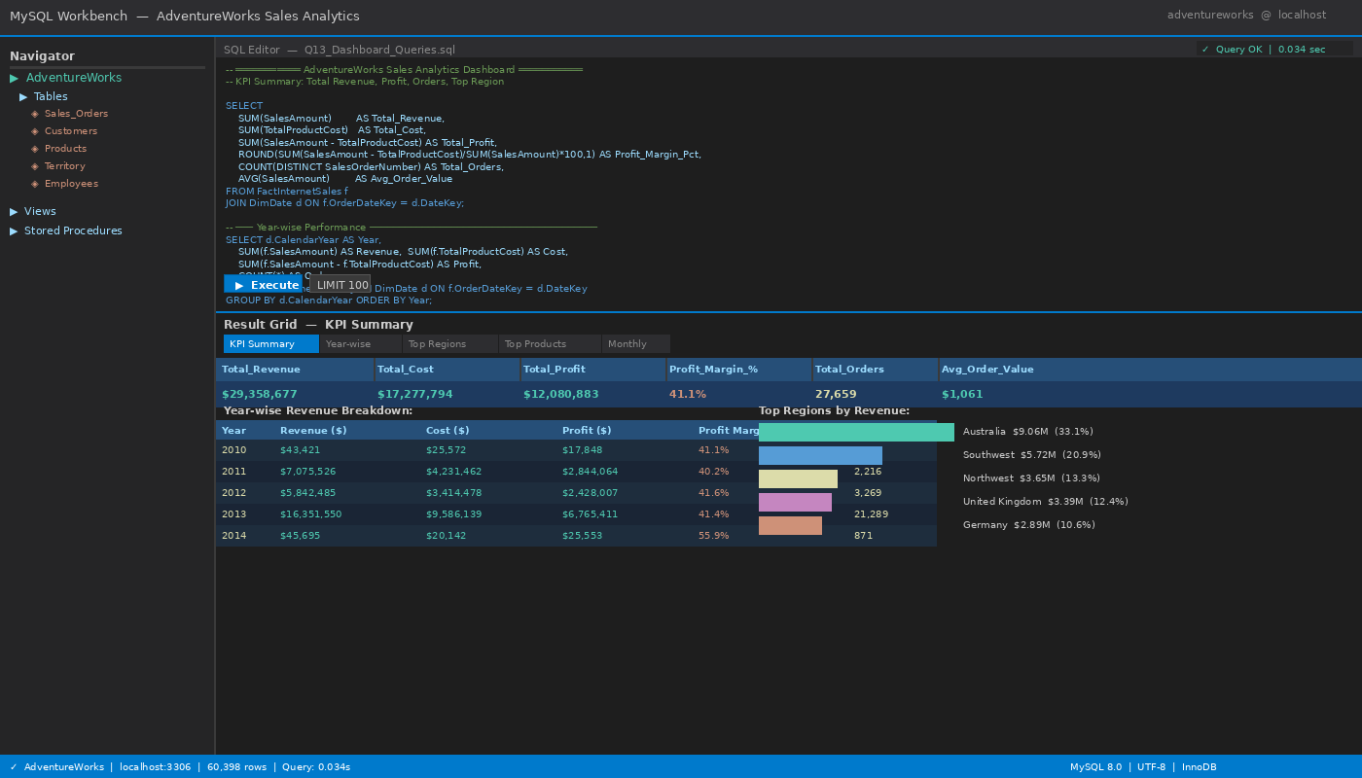
🗄️ MYSQL DASHBOARD – SQL Queries
Total Revenue by Category
SELECT Category,
SUM(TotalAmount) AS Revenue
FROM Orders
JOIN Products USING(ProductID)
GROUP BY Category
ORDER BY Revenue DESC;
Monthly Sales Trend
SELECT MONTH(OrderDate) AS Month,
SUM(TotalAmount) AS Sales
FROM Orders
GROUP BY Month
ORDER BY Month;

Slide 5
🗄️ MYSQL DASHBOARD – Query Outputs & Role of SQL
Sample Query Output – Revenue by Category
Category | Revenue (USD) | % Share
Bikes | $28,318,144 | 62.1%
Accessories | $9,071,502 | 19.9%
Clothing | $3,214,965 | 7.1%
Components | $5,009,000 | 10.9%
How SQL Helps in Backend Data Analysis
Extracts raw data directly from relational databases with precision
Handles complex multi-table JOINs and aggregations efficiently
Filters, groups, and sorts large datasets that Excel cannot manage
Forms the data foundation for Power BI and Tableau dashboards
Enables repeatable, automated data pipelines for reporting

Slide 6
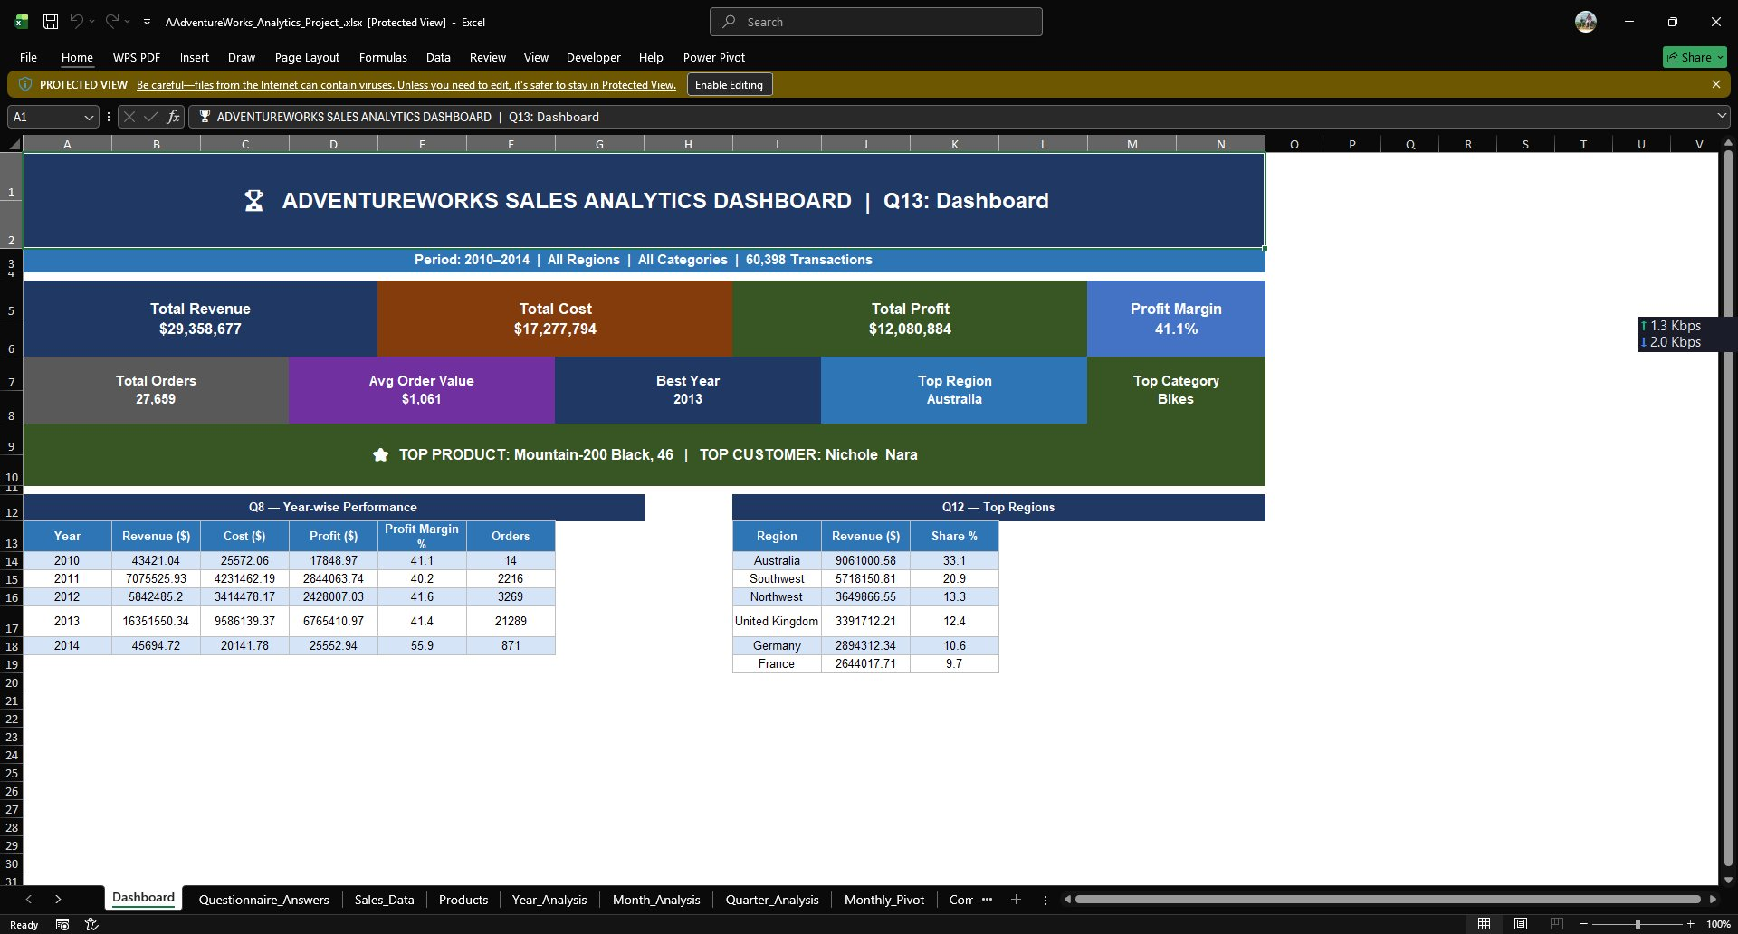
📗 EXCEL DASHBOARD – Analysis & Visualizations
Pivot Tables
Summarize sales by region, product, and period
Bar & Line Charts
Visualize monthly trends and comparisons
Slicers & Filters
Interactive filtering by year, category, city
Conditional Format
Highlight top performers and outliers
VLOOKUP / IF
Formula-driven dynamic data linking
Excel provides quick, accessible dashboards without coding — ideal for smaller datasets and business teams familiar with spreadsheets.

Slide 7
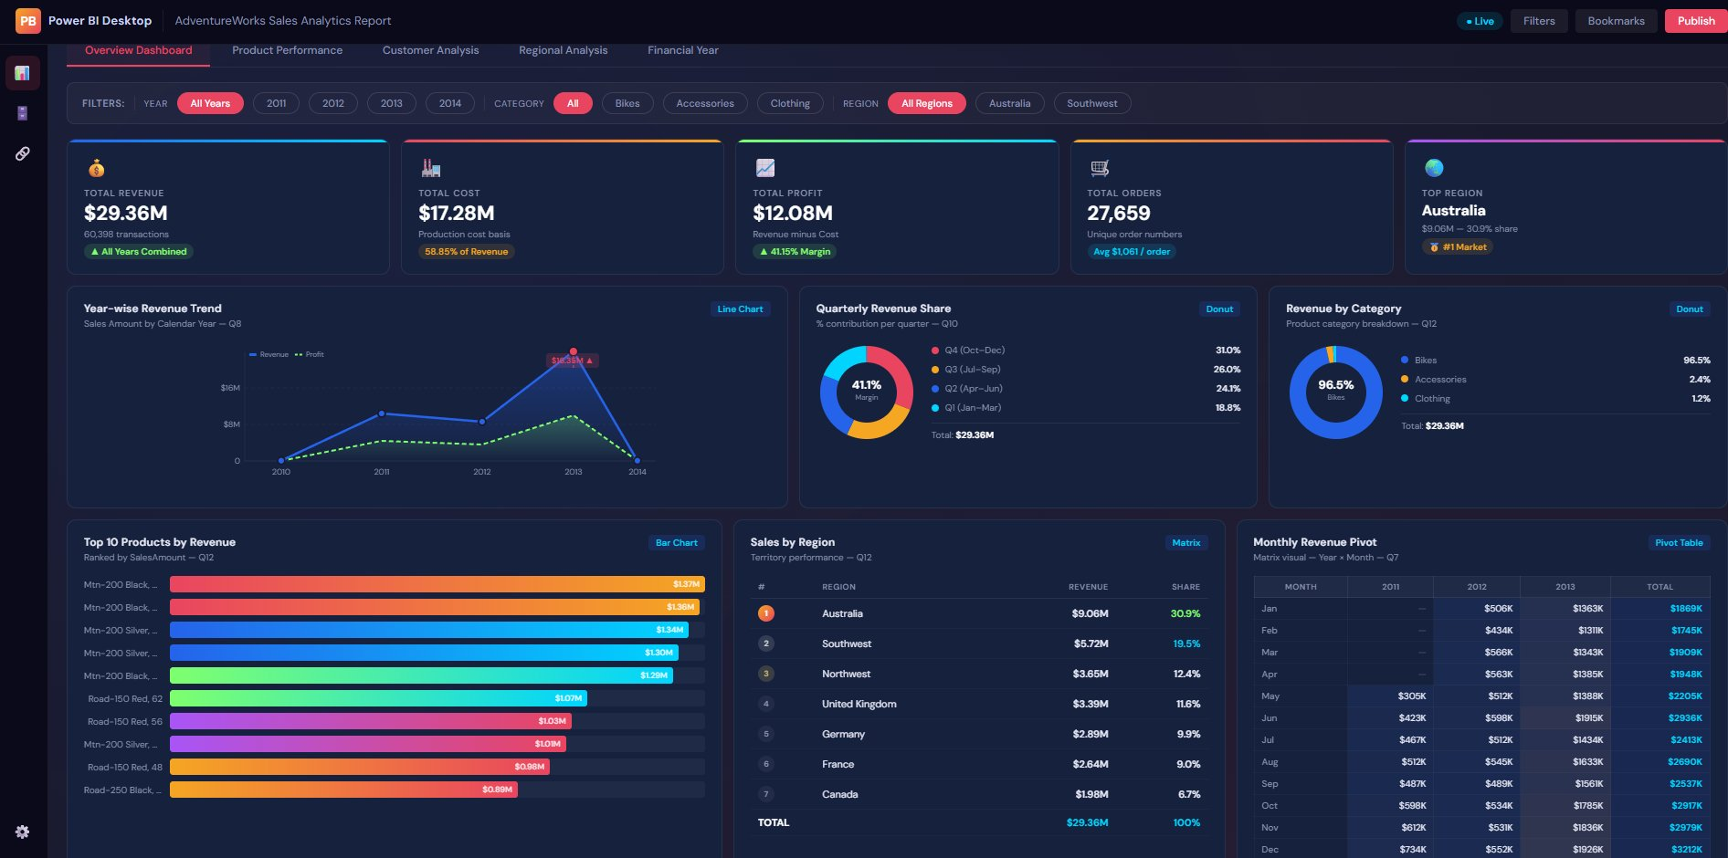
⚡ POWER BI DASHBOARD – Interactive KPI Reports
DAX Measures
Custom KPI calculations using DAX formulas
Interactive Filters
Slicers and cross-filtering between visuals
KPI Cards
Total Revenue, Orders, Avg Order Value at a glance
Drill-Through
Click to explore region and product details
Live Refresh
Auto-updates when connected to live data
Power BI turns raw data into rich, interactive reports — empowering non-technical users to explore data and make decisions instantly.

Slide 8
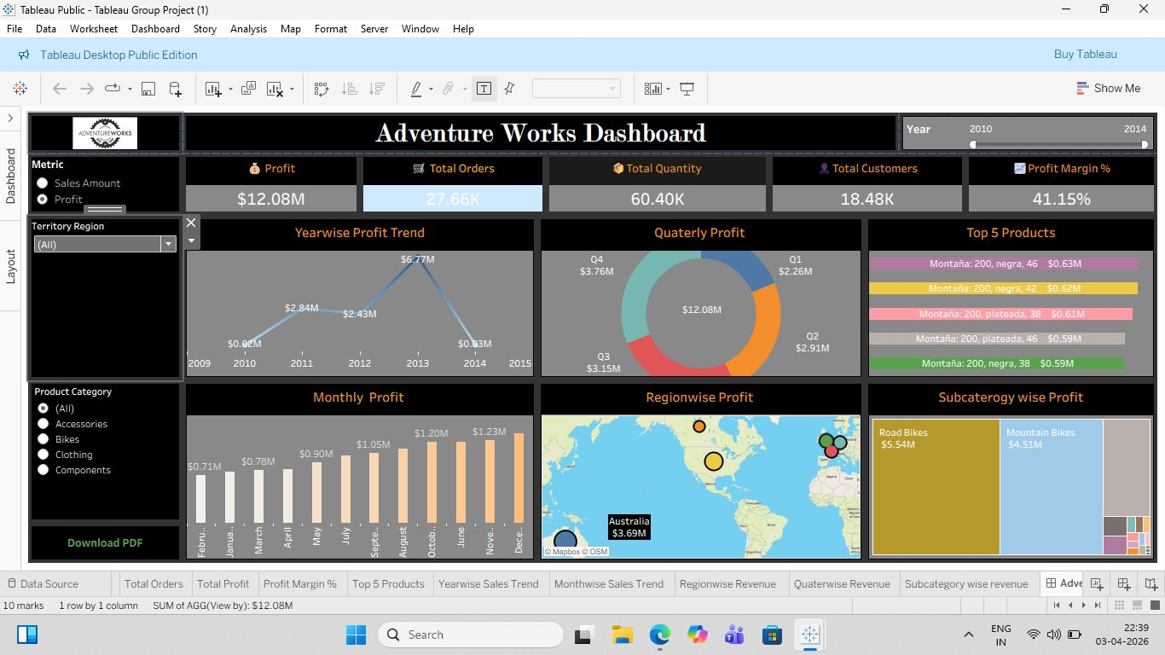
📊 TABLEAU DASHBOARD – Storytelling & Advanced Visuals
Story Points
Guide audience through data narratives step-by-step
Map Visuals
Geographic sales distribution across regions/cities
Calculated Fields
Custom metrics built directly in Tableau
Actions & Filters
Click-through interactions between worksheets
Dashboard Layout
Polished, publication-ready visual design
Tableau excels at visual storytelling — transforming complex data into intuitive, beautiful visuals that communicate insights at a glance.

Slide 9
KEY PERFORMANCE INDICATORS (KPIs) – What They Mean for Business
💰
Total Revenue
📈
Monthly Sales Trend
What: Sum of all sales across all orders and products
What: Revenue plotted month-by-month over time
Why it matters: Tells the client how much the business is earning — the #1 health indicator
Why it matters: Reveals seasonal patterns, growth or decline, and best/worst months
🏆
Top Products
🌆
Sales by City
What: Products ranked by revenue or quantity sold
What: Geographic breakdown of revenue by city or region
Why it matters: Helps focus marketing and inventory efforts on best-selling items
Why it matters: Identifies strong and weak markets — guides regional strategy
🔄
Repeat Customers
What: Count of customers who placed more than one order
Why it matters: Measures loyalty and retention — cheaper to retain than acquire new customers

Slide 10
BUSINESS IMPACT OF DASHBOARDS
How dashboards empower clients to make smarter decisions, faster
⚡
Quick Decision-Making
👁️
Easy Understanding
Real-time visuals eliminate the need for manual reports — managers can act on data within seconds, not days.
Charts and KPI cards simplify complex datasets so any stakeholder — even non-technical — can interpret results.
🔍
Identifying Trends
📈
Improving Performance
Trend lines, month-over-month comparisons, and heatmaps reveal patterns and opportunities before they are missed.
By tracking KPIs continuously, businesses can set targets, monitor progress, and course-correct in real time.

Slide 11
CONCLUSION
We successfully built dashboards using MySQL, Excel, Power BI, and Tableau on the AdventureWorks dataset
Each tool offered unique strengths — from SQL's data power to Tableau's visual storytelling
Key KPIs like Total Revenue, Monthly Trends, and Top Products provided actionable business insights
This project strengthened our skills in data analytics, dashboard design, and business communication
Tools Mastered:
MySQL
Excel
Power BI
Tableau
Thank You!
Group 6 • Sales Dashboard Project

